Slide 1
Visual Intelligence

Slide 2
What is Artificial Intelligence?

Slide 3
Types of Intelligence
Machine Intelligence
Visual Intelligence
Audio Intelligence
Text Intelligence

Slide 4
Visual Intelligence
Intelligence generated by processing images

Slide 5
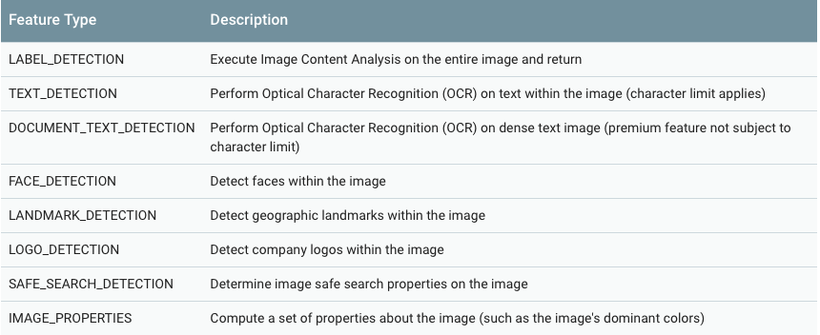
Some API's
Google Vision API

Slide 6
Microsoft API
Face Identification
2. Face Verification
3. Face Grouping
4. Emotion Recognition

Slide 7
Use Cases
Google Lens
E-Commerce
Emotion Detection
Text Extraction
Face Lock
Image Labelling

Slide 8
References
https://cloud.google.com/vision/docs/
https://medium.com/@srobtweets/exploring-the-cloud-vision-api-1af9bcf080b8
https://medium.com/@calloncampbell/using-the-face-api-from-microsoft-cognitive-services-part-1-face-detection-1f310631b04b
https://azure.microsoft.com/en-in/services/cognitive-services/computer-vision/
https://hackernoon.com/optical-character-recognition-with-google-cloud-vision-api-255bb8241235
https://medium.com/@PradyumnaKulkarni/cloud-vision-api-how-it-will-transform-the-visual-recognition-1cd1eff66cb2
https://www.paralleldots.com/
https://goberoi.com/comparing-the-top-five-computer-vision-apis-98e3e3d7c647

Slide 9
Thank you

